Slide 1
Database Development for DreamHome
By Joshua Troup

Slide 2
Examining Documentation
All documents which are used within a system need to be examined. These will be eventually duplicated, replaced with alternative versions, or even discarded in the new system.
Types include: Data capture forms, System documentation, Business reports, Invoices, Bills, Records, Letters, Etc.

Slide 3
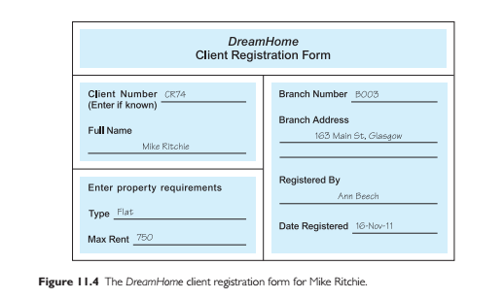
Example of Documentation

Slide 4
Interviewing
Most commonly used, and normally most useful, fact-finding technique. Enables collection of information from individuals face-to-face.
Objectives include finding out facts, verifying facts, clarifying facts, generating enthusiasm, getting the end-user involved, identifying requirements, and gathering ideas and opinions.

Slide 5
Observing the enterprise in operation
An effective technique for understanding a system.
Possible to either participate in, or watch, a person perform activities to learn about the system.
Useful when validity of data collected is in question or when the complexity of certain aspects of the system prevents a clear explanation by the end-users.

Slide 6
Research
Useful to research the application and problem.
Use computer trade journals, reference books, and the Internet (including user groups and bulletin boards).
Provide information on how others have solved similar problems, plus whether or not software packages exist to solve or even partially solve the problem.

Slide 7
Questionnaires
Conduct surveys through questionnaires, which are special-purpose documents that allow facts to be gathered from a large number of people while maintaining some control over their responses.
There are two types of questions, namely free-format and fixed-format.

Slide 8
Free Format Vs. Fixed Format
Fixed = Multiple choice questions, Rating questions, Ranking questions—Much easier to tabulate.
Free = Multiple word answers(fill in blank questions), Opinionated/Explain questions—Much harder to tabulate.

Slide 9
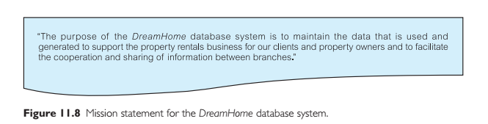
Mission Statement

Slide 10
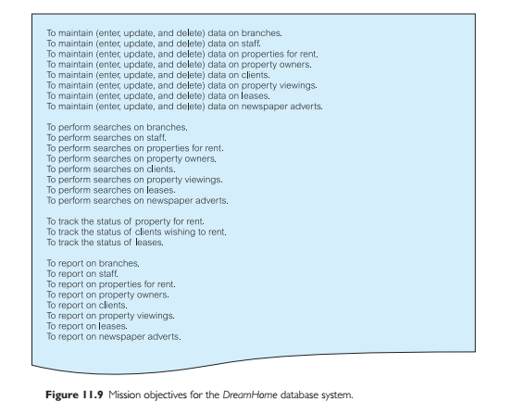
Mission Objectives

Slide 11
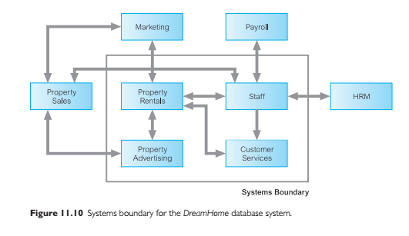
High Level Systems Diagram

Slide 12
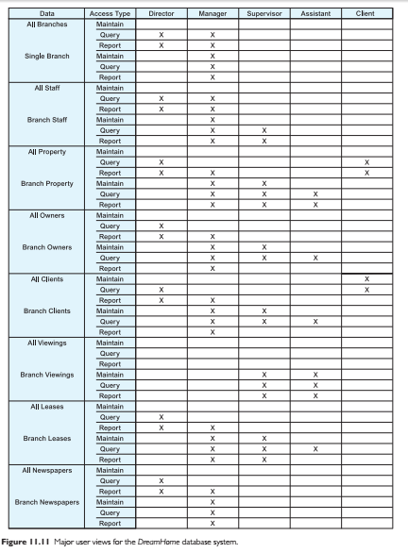
High Level Requirements User View

Slide 13
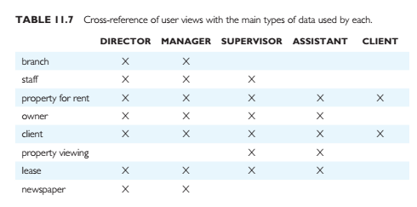
Cross Reference User Views

